Slide 1
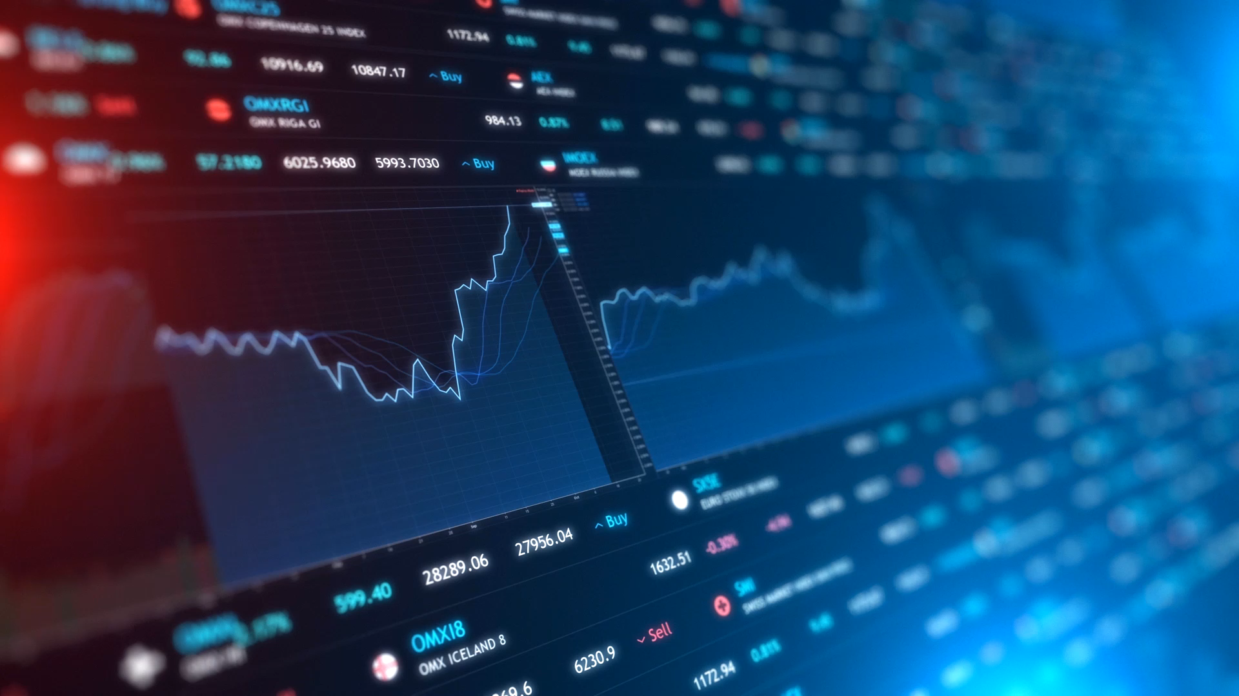
DIRECTIONAL CHANGE DETECTION IN FINANCIAL MARKETS

Slide 2

TABLE OF CONTENT
INTRODUCTION
RESEARCH PROBLEM
RESEARCH GOAL
DATASET
DATA PREPROCESSING
STATISTICAL ANALYSIS
EXPLORATORY ANALYSIS
REINFORCEMENT LEARNING
CREATING AN ENVIRONMENT
GENERATING Q-TABLES
RESULTS
LIMITATION
REFERENCES

Slide 3

introduction
Stock markets are marketplaces where investors may purchase and sell stock in firms, raising funds and potentially earning from price gains.
They are critical to promoting expenditures, economic expansion, and resource allocation.

Slide 4

RESEARCH PROBLEM
Developing a profitable trading strategy is critical in algorithmic trading since it directly influences the chances of generating consistent profits.
Developing a profitable trading strategy is critical in algorithmic trading since it directly influences the chances of generating consistent profits.
Problem: One of the most difficult aspects of financial market trading is determining an effective trading rule that can adapt to changing market conditions.

Slide 5

RESEARCH GOAL
The proposed strategy suggested DCRL trading method combines methods from RL and a DC event approach.
Goal: The Q-learning algorithm training the DCRL trading strategy to find the optimal rule for maximizing trading results. To measure the success of the DCRL investment approach, we conduct experiments using real data from the stock market, especially the S&P500, between 2015 and 2024.

Slide 6

DATASET
The Dataset is from the Yahoo Finance website.
Pre-covid : Jan 2015- Nov 2019
Post-covid: Dec 2019 – Jan 2024
The dataset contains:
Date
Open
High
Low
Close
Adj Close
Volume
This Photo by Unknown Author is licensed under CC BY

Slide 7
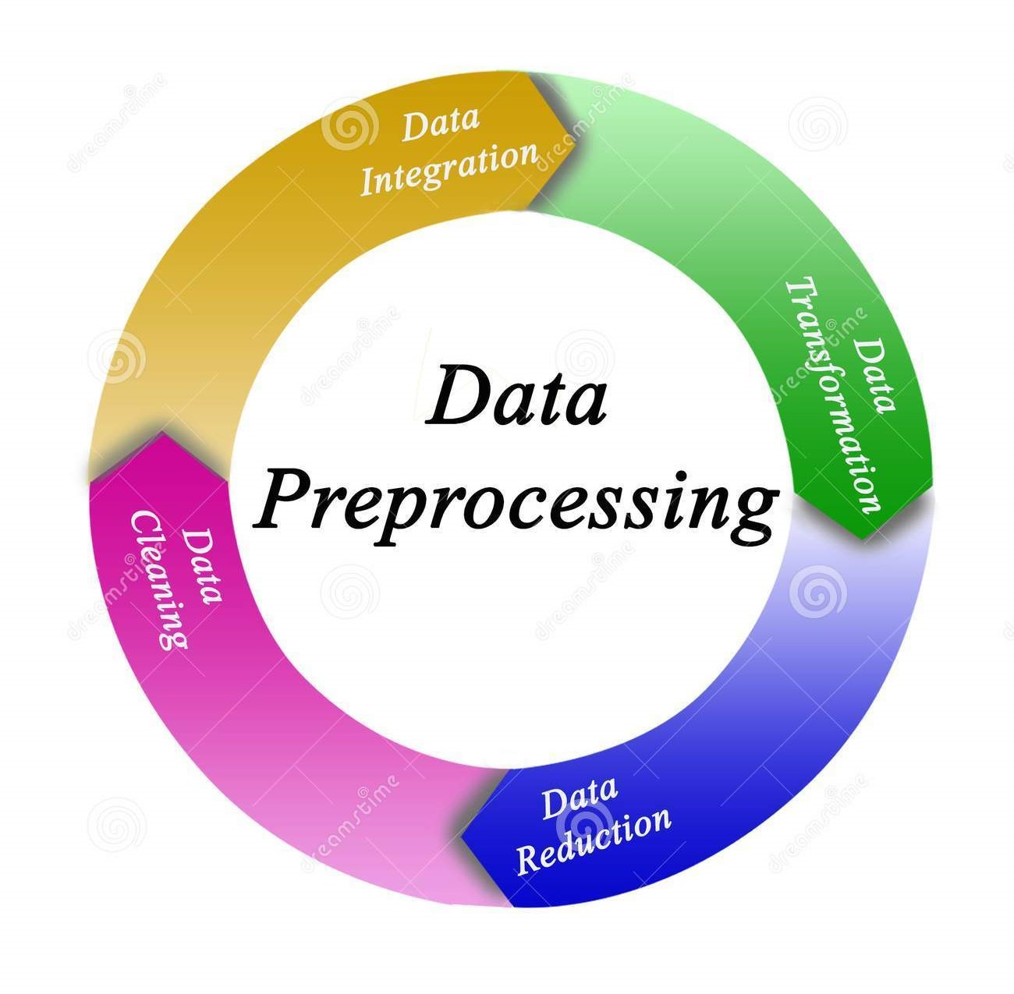
Data preprocessing
Checked for Null values
Checked for datatype of the variables
Convert the type of date into datetime

Slide 8
Statistical ANALYSIS
Pre Covid-Data | Post Covid-Data
Size: 1237 Count:1237.000000 Mean: 2440.350193 std 347.629586 min 1829.079956 max 3153.629883 Volatility (Daily) 0.851448 Volatility (Annualized) 13.516317 | Size: 1047 count 1047.000000 Mean 3966.982505 std 538.393417 min 2237.399902 max 4927.930176 Volatility (Daily) 1.424849 Volatility (Annualized) 22.618777

Slide 9
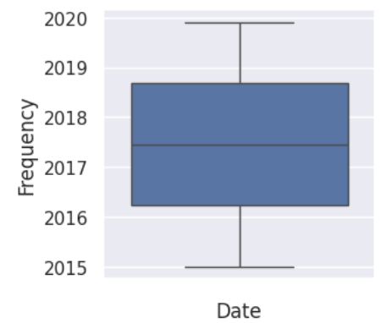
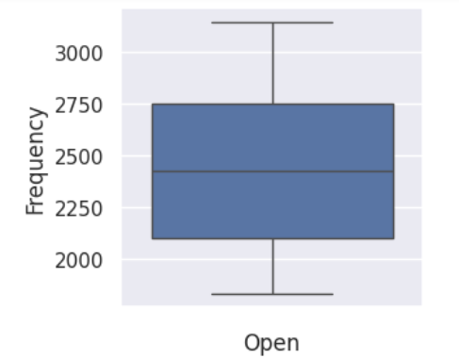
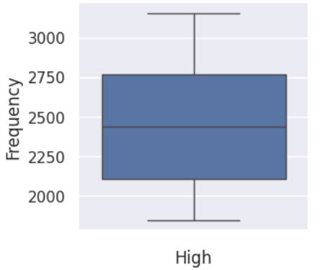
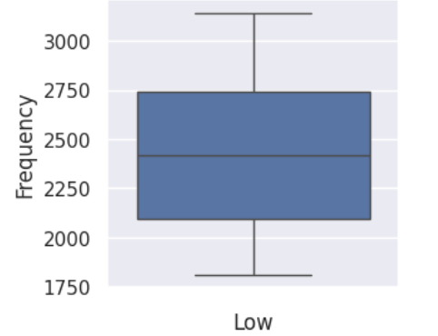
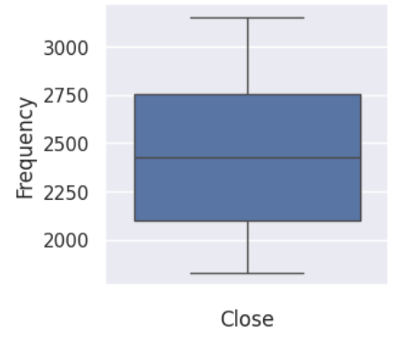
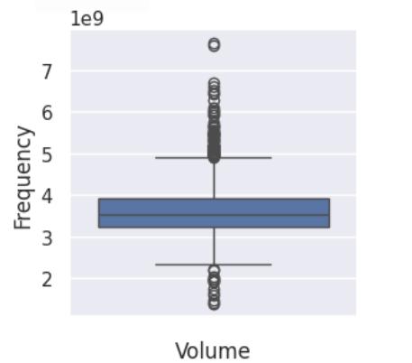
EXPLORATORY ANALYSIS
Outliers for pre-covid dataset
We could see the outliers in the volume variable and the rest of the variables are good.
Therefore, we can drop the variable volume as a part of feature engineering.

Slide 10
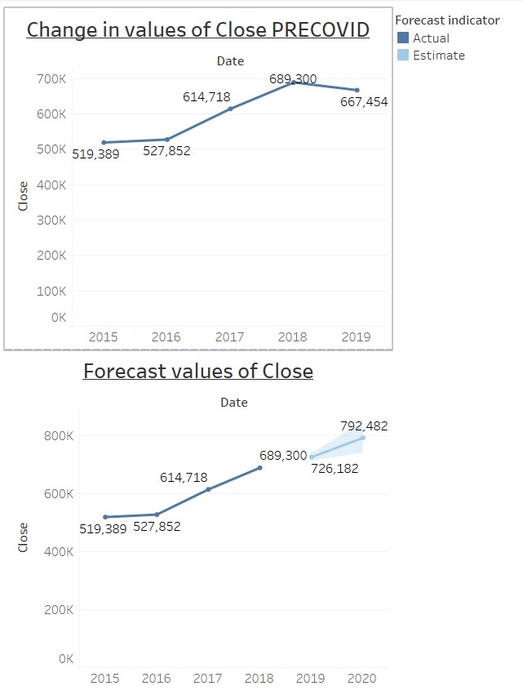
EXPLORATORY ANALYSIS
This graph shows the changes in the
close for pre-covid.
This graph shows the forecast in the
close for pre-covid.

Slide 11
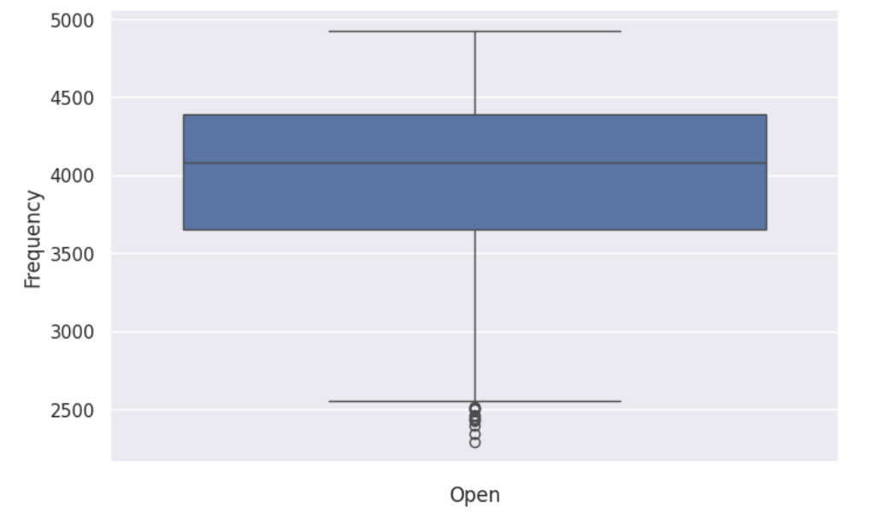
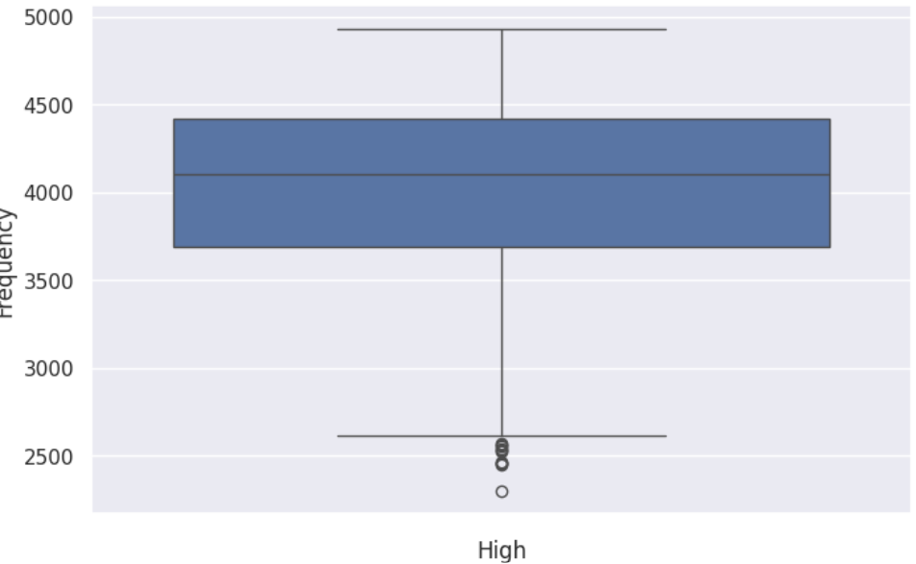
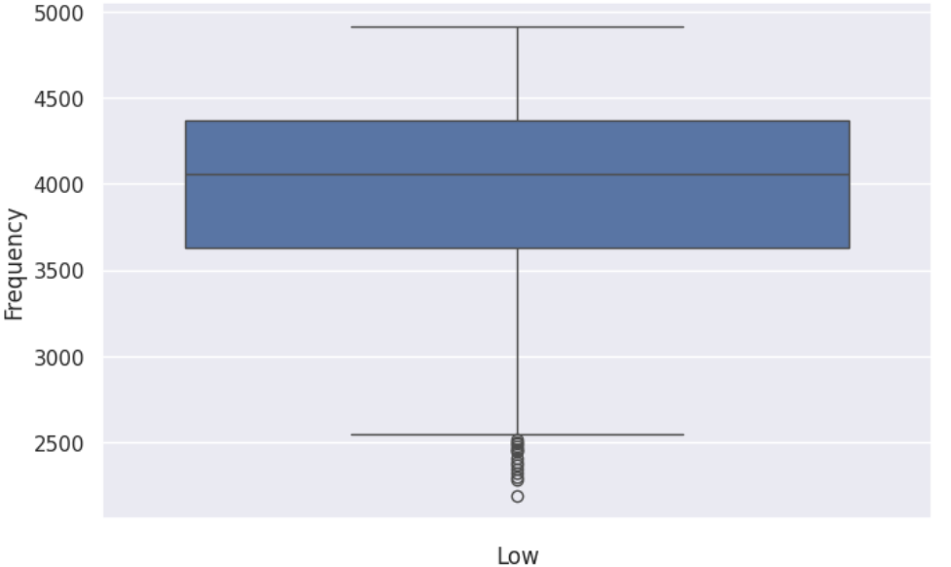
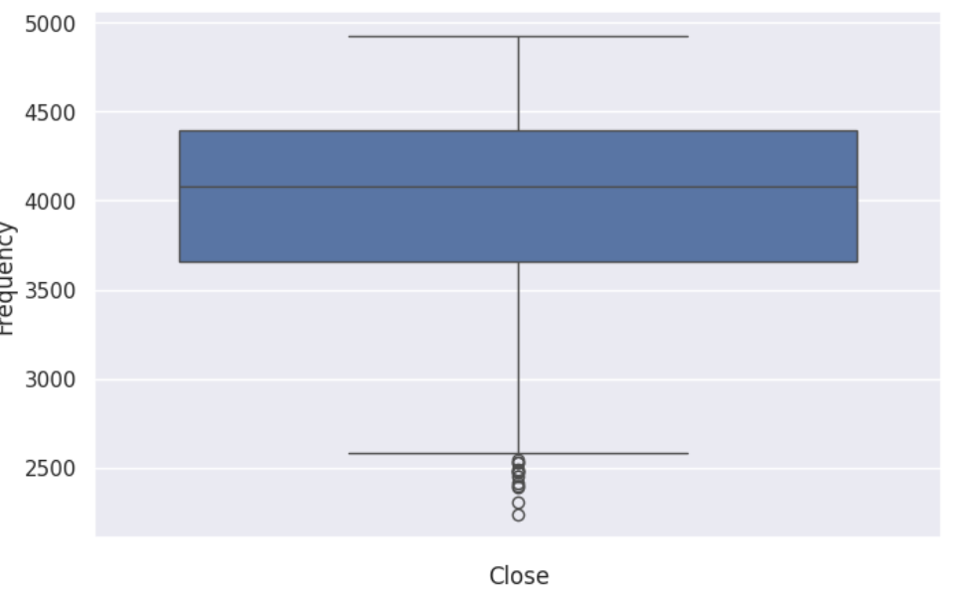
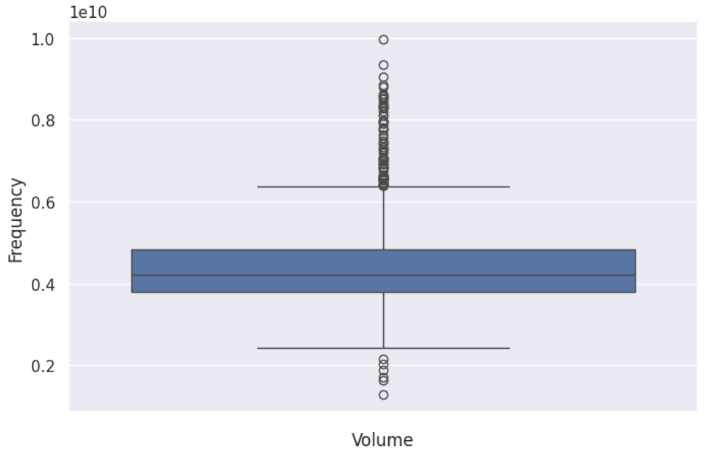
EXPLORATORY ANALYSIS
Outliers for post-covid dataset
We could see the outliers in the volume variable and the rest of the variables are good.
Therefore, we can drop the variable volume as a part of feature engineering.

Slide 12
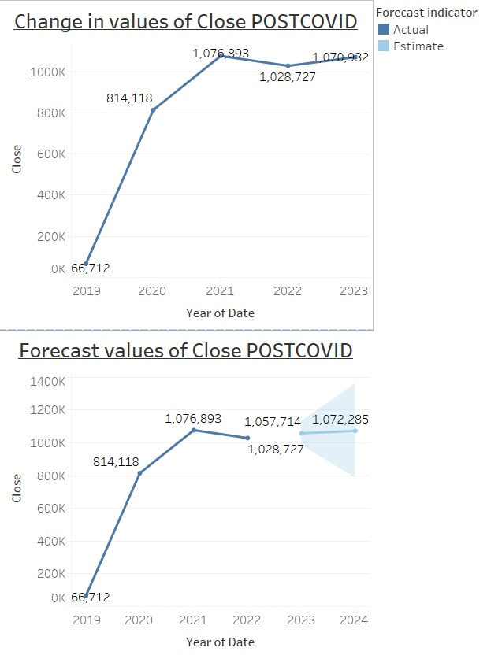
EXPLORATORY ANALYSIS
This graph shows the changes in the
close for post-covid.
This graph shows the forecast for the
close for post-covid.

Slide 13

REINFORCEMENT LEARNING
DCRL (Directional Change Recognition with Reinforcement Learning) is a method used for detecting directional changes in financial markets. It involves an agent analyzing the market's environment, using financial data to represent the current state, making decisions based on the market's direction, and receiving rewards for successful predictions. This process helps the agent continuously learn and adapt its strategy.
This Photo by Unknown Author is licensed under CC BY-SA-NC

Slide 14
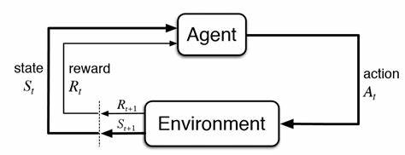
Creating an environment
States: We have Price Unchanged, Price Decreased, Price Increased
Action: We have Hold, Sell, Buy
Rewards: We would reward 1,0,-1
Exploration rate (epsilon) = 0.1
Learning rate (alpha) = 0.1
Discount factor (gamma) = 0.9

Slide 15
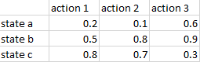
GENERATING Q-TABLES
To train a program to identify possible gains in financial markets using Q-learning,
we built a simulated environment.
We utilized the Bellman equation to update the Q-values in the table.
Q(s, a) = E[R + γ * max[Q(s', a')] | s, a]
where,
Q(s, a) is the value of acting a in state s,
γ is the discount factor,
max[Q(s', a')] represents the maximum value of the action value function over all possible actions a' in the next state s'.
The value associated with a state-action combination is defined as the expected immediate advantage plus the discounted cost of the optimal action to take in the following state.
This Photo by Unknown Author is licensed under CC BY-SA

Slide 16
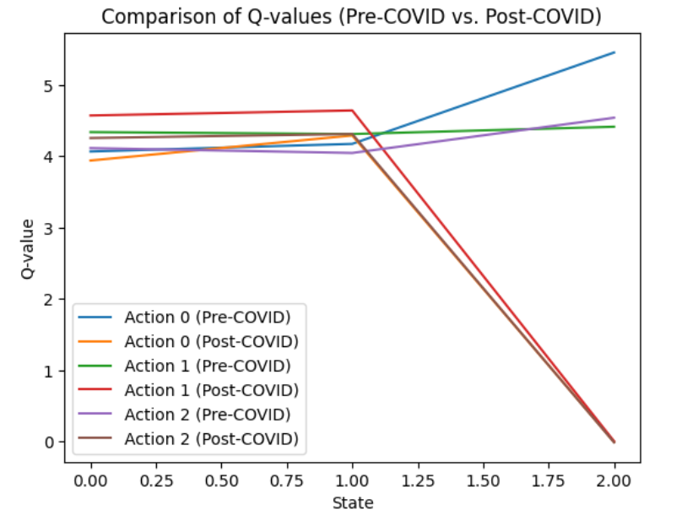
RESULTS
In this graph, the directional changes can be seen clear
Initially, the pre-covid values were the increases as the state values increased based on the states in the Q-table.
Finally, the post-covid values were decreasing as the state values increased based on the states in the Q-table.

Slide 17
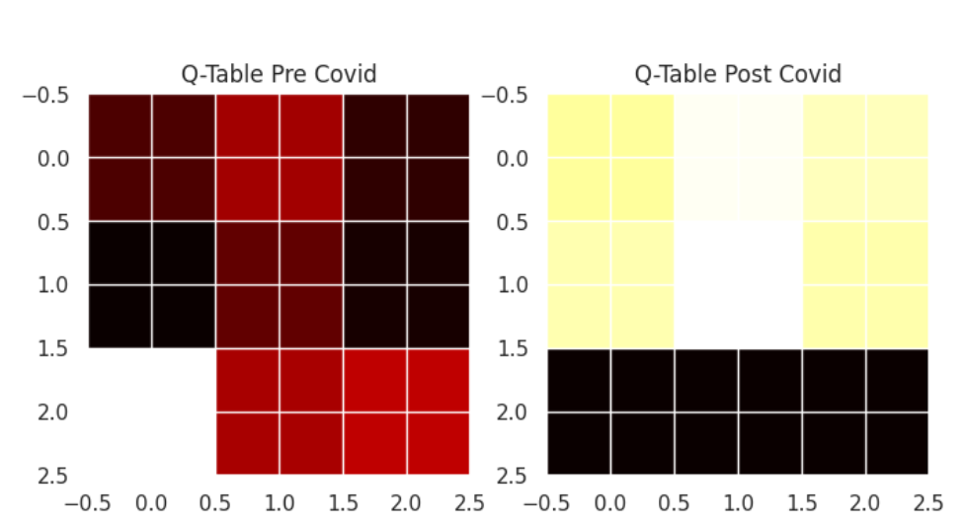
RESULTS
Even this graph shows the directional
changes based on the Q-Table
The pre-covid table shows there are few negative changes when compared with the post covid.
The post-covid table shows there is
a lot of the changes when compared
with the pre-covid Q-table.
MSE value is 7.746193852631523

Slide 18

LIMITATIONS
If you initialize all Q-values to zero, the agent might get stuck exploiting the initial state, neglecting other potentially better options.

Slide 19
REFERENCES
Treleaven, P., Galas, M., & Lalchand, V. (2013). Algorithmic trading review. Communications of the
ACM, 56(11), 76-85.
Aloud, M. E., & Alkhamees, N. (2021). Intelligent algorithmic trading strategy using reinforcement learning and
directional change. IEEE Access, 9, 114659-114671.
Li, X., Deng, X., Zhu, S., Wang, F., & Xie, H. (2014). An intelligent market making strategy in
algorithmic trading. Frontiers of Computer Science, 8, 596-608.
Dubey, R. K. (2022). Algorithmic Trading: The Intelligent Trading Systems and Its Impact on Trade Size.
Expert Systems with Applications, 202, 117279.

Slide 20
Any queries ?
THANK YOU

